Slide 1
Component Object Model
A Technical Overview
Phaniraj B.N.
Course ID.1A
Bangalore-560050

Slide 2
Abstract
This program tells you about COM, a software Architecture that allows the components made by different software vendors to be combined into a variety of applications
It defines a standard for component interoperability, which is not dependent on any particular programming language, available on multiple platforms, and is extensible

Slide 3
Introduction
The Component Object Model (COM) is a component software architecture that allows applications and systems to be built from components supplied by different software vendors
It is the underlying Architecture for high level Software services like OLE, Active-X etc.

Slide 4

Removable software?

Slide 5
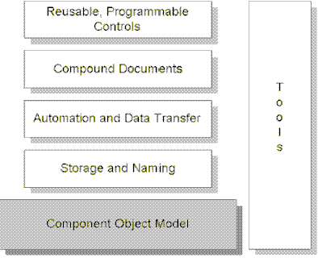
High-level OLE Application Services Are Built on the Common Component Object Model Foundation.

Slide 6
Features of COM
Defines a binary standard for component interoperability.
Is programming language-independent.
Is provided on multiple platforms (Microsoft® Windows®, Microsoft Windows NT™, Apple® Macintosh®, UNIX®).
Provides for robust evolution of component-based applications and systems.
Is extensible.

Slide 7
Mechanisms
Communications between components, even across process and network boundaries
Shared memory management between components
Error and status reporting
Dynamic loading of components

Slide 8
Problems in the Current Trend!
Pure Inter-Operability.
Versioning.
Language Independency.
DLLs.
Transparent Cross-Process Interoperability.
Even with all this, high performance.

Slide 9
COM Fundamental Concepts
A binary standard for function calling between Components.
A provision for the Strongly-typed groupings of Functions as Interfaces.
A way for Components to dynamically invoke interfaces implemented.

Slide 10
COM Fundamental Concepts
A Reference-Counting to track their own life-time and delete themselves when appropriate.
A mechanism to uniquely identify the Components.
A "component loader" to set up component interactions and additionally in the cross-process and cross-network cases to help manage component interactions.

Slide 11
Binary Standard
For a given Platform, COM defines a standard way to layout virtual Function tables in memory.
It also has a standard way of calling functions thro’ the v-tables.
Any language that can call functions via pointers can be used to write components that can interoperate with other components written to the same binary standard.

Slide 12
Binary Standard
The double indirection (The client holds a pointer to a pointer to a vtable) allows for vtable sharing among multiple instances of the same object class
On a system with hundreds of object instances, vtable sharing can reduce memory requirements considerably.

Slide 13
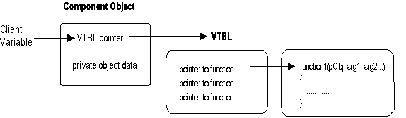
Diagram of a vtable

Slide 14
Objects and Components
An object is some piece of compiled code that provides some service to the rest of the system.
It is best to refer to a COM object as a "component object" or simply a component.
COM objects support a base interface called IUnknown, along with any combination of other interfaces, depending on what functionality the component object chooses to expose.

Slide 15
Components and Objects
Component Objects access other Objects thro’ Interface pointers.
This feature makes Encapsulation happen in COM along with Remoting.

Slide 16
Interfaces
Applications interact with each other and with the system thro’ Interfaces.
It’s a strongly-typed contract b/w components to provide small but semantically related operations:Methods.
An interface is a expected behavior and expected responsibilities.
A pointer to a Component means a pointer to the interface that the Component implements.

Slide 17
Attributes of an Interface
A interface is not a class.
It is not a Component Object.
Clients only interact with pointers to the interface.
The Object can implement Multiple Interfaces.
Interfaces are strongly-typed.
Interfaces are Immutable.

Slide 18
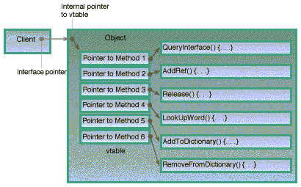
How an interface pointer looks in object

Slide 19
Types of Interfaces
Standard Interfaces:
  They are defined by COM library.
  E.g.: IUnknown, IDispatch Interfaces.
Custom Interfaces:
  They are created by Third-party venders or yourself for your own use.
  E.g.: IWroxInterface in the Example.

Slide 20
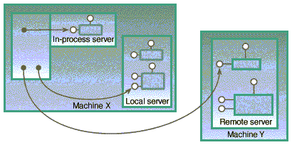
    Three kinds of servers.

Slide 21
Benefits Of COM
Ability for Functionality in Applications to Evolve over time.
Fast and simple Object interaction.
Interface Reuse
Local/Remote transparency.
Programming Language Independence.

Slide 22
Globally Unique Identifiers
They are 128-bit integers that are guaranteed to be unique in the world across space and time.
To identify every interface and every component object class, we use them.
Microsoft supplies a tool (uuidgen.exe) that automatically generates GUIDs.
The GUIDs are embedded in the component binary itself and are used by the COM system dynamically at bind time to ensure that no false connections are made between components.

Slide 23
Interface definition in C++:
class IUnknown{
public:
__stdcall virtual void HRESULT QueryInterface(REFIID riid,
void** ppvobject)=0;
__stdcall virtual ULONG AddRef()=0;
__stdcall virtual ULONG Release()=0;
};

Slide 24
Interface definition using Macros:
interface IUnknown{
STDMETHOD(QueryInterface)(REFIID riid, void** ppvObj)
PURE;
STDMETHOD_(ULONG,AddRef) ( ) PURE;
STDMETHOD_(ULONG,Release) ( )PURE;
};
DEFINED IN
<basetyps.h>

Slide 25
Interface Definition Language:
[
local,
object,
uuid(-------------------------------------------),
]
interface Iunknown
(
HRESULT QueryInterface(
[in] REFIID,riid,
[out],iid_is(riid)] void** ppvObject);
ULONG AddRef();
ULONG Release();
)
This object attribute says
that it’s a COM Object

Slide 26
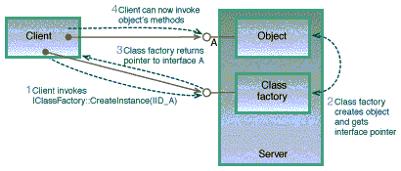
    Creating an object with a class factory.

Slide 27
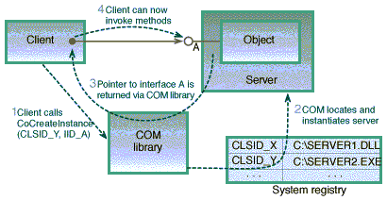
    Creating an object with CoCreateInstance.

Slide 28
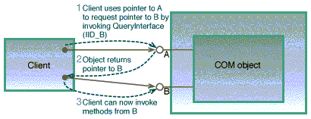
    Using IUnknown::QueryInterface.

Slide 29
Client COM support OS In-proc server Class-factory Object
1:CoCreateInstance
2:CogetclassObject()
3:Check registry for object Info
4:Object Info
5:Load Library on In-proc server DLL
6:Call DllGetClassObject()
7:Create Class Factory object
8:Return Pointer to IClass Factory
9:Call IClasssFactory::CreateInstance()
10:Create COM object
11:Return pointer to IUnknown Interface
12:Call IClassFactory:: Release() to free class factory object
13:Release IUnknown of COM object

Slide 30
IUnknown Interface
All component objects are required to implement the IUnknown interface
All COM and OLE interfaces derive from IUnknown.
IUnknown has three methods: QueryInterface, AddRef, and Release.
AddRef and Release are simple reference counting methods
QueryInterface is the mechanism that a client uses to get an interface pointer from a component object.

Slide 31
Component Object Library
The COM Object library is the system Component that provides the mechanics of COM.
It provides the feature of calling COM Components across processes thro’ IUnknown.
COM library is implemented as part of OS and provides “LEGWORK” associated with finding and launching of COM Components.

Slide 32
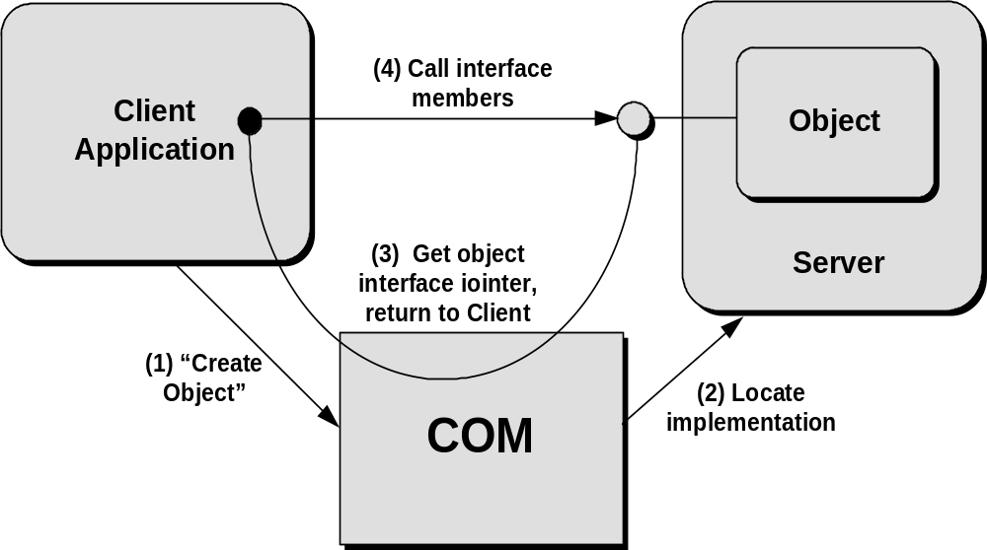
Clients locate and access objects through implementation locator services in COM.

Slide 33
COM solves the Component Software Problem:
COM solves the four basic Problems associated with component Software:
  Basic Component Interoperability.
  Versioning
  Language Independence.
  Transparent Cross-process Interoperability.

Slide 34
Basic Interoperability
This is provided by COM's use of vtables to define a binary interface standard for method calling between components.
Calls between COM components in the same process are only a handful of processor instructions slower than a standard direct function call and no slower than a compile-time bound C++ object invocation.

Slide 35
Versioning
A good versioning mechanism allows one system component to be updated without requiring updates to all the other components in the system
Versioning in COM is implemented using interfaces and IUnknown::QueryInterface.
The COM design completely eliminates the need for things like version repositories or central management of component versions.

Slide 36
Language Independence
COM objects can be written in no of languages and implemented in completely different Programming languages.
This is possible because COM objects are represented in Binary Object standard.
This acts as major benefit over OOPs.

Slide 37
Transparent Cross-Process Interoperability
This is made easy by making developers think that all interactions between components occur in same Processes.
The COM Library is the key to providing transparent cross-process interoperability
Component objects can interoperate freely with other component objects running in the same process, in a different process, or across the network.

Slide 38
Local/Remote Transparency
COM is designed to allow clients to transparently communicate with components regardless of where those components are running
From a client's point of view, all component objects are accessed through interface pointers.
From a server's point of view, all calls to a component object's interface functions are made through a pointer to that interface.

Slide 39
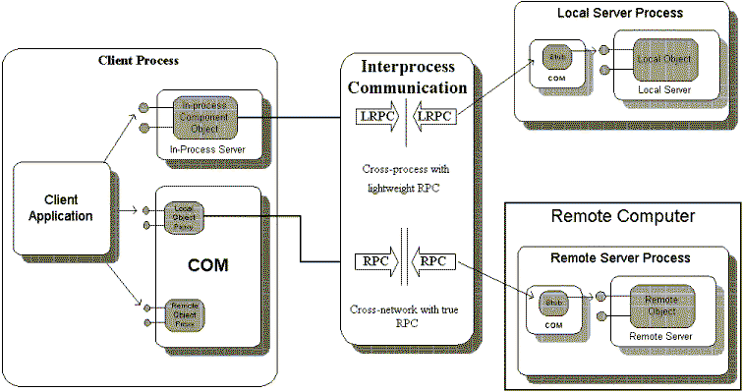

Slide 40
The Key Benefits:
A common solution for the problems that is independent of the distance between the client and the server.
Programmers leverage their learning.
Systems implementation is centralized.
Interface designers concentrate on mainly design.

Slide 41
COM and Client-Server model
“Client " refers to some piece of code that is using the services of a COM object.
“Server"—the component object that serves those capabilities.
Crash protection can be provided between the different components making up an application as they can reside in different Processes.
COM is unique in allowing clients to also represent themselves as servers.

Slide 42
In-process and Out-Of-Process
A server is "in-process" which means its code executes in the same process space as the client (as a DLL).
“Out-of-Process" means it runs in another process on the same machine (Out of Process-LOCAL) or in another process on a remote machine(Out of Process-REMOTE) (as a .EXE file).
COM object implementers choose the type of server based on the requirements of implementation and deployment.

Slide 43
    Three kinds of servers.

Slide 44
Custom Interfaces and definitions
If one defines a new interface, he can create an interface definition using the Interface Definition Language (IDL).
From these interface definitions, the MIDL compiler generates header files for use by applications using that interface.
IDL is not necessary unless you are defining a custom interface for an object.
An Example is shown

Slide 45
COM and Application Structure
It is a specification for how applications interoperate.
It is partly implemented by COM Library.
COM, through language-independent interfaces, picks up where programming languages leave off, providing network-wide interoperability of components to make up an integrated application.

Slide 46
COM Reusability Mechanisms
The key point to building reusable components is black-box reuse.
The piece of code attempting to reuse another component knows nothing—and does not need to know anything—about the internal structure or implementation of the component being used.
COM uses 2 mechanisms for this :
  Containment.
  Aggregation.

Slide 47
Containment
Here the Outer object behaves like an object client to the Inner object.
When the outer object wishes to use the services of the inner object, the outer object simply delegates implementation to the inner object's interfaces.
This is similar to Containment in C++.
It is also called as Delegation.

Slide 48
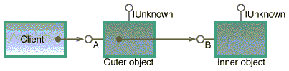
Reusing Components thro’ Containment.

Slide 49
Aggregation
The outer object wishes to expose interfaces from the inner object as if they were implemented on the outer object itself.
The Inner object’s pointer is directly got by the client.

Slide 50
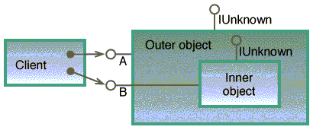
Object Reuse in Aggregation

Slide 51
Steps for creating COM
Create the IDL file first.
  It is where you define the functions.
Pass the IDL file thro’ the MIDL compiler.
Create the header file with implementations.
Create a .cpp file for writing the DLL utility fns.
Create the definition file for the DLL-Export fns.
Create the Class-factory header file and write its implementations- CreateInstance and LockServer.
Register the COM object and view it thro’ the COM viewer.

Slide 52
Summary
The core of the Component Object Model is a specification for how components and their clients interact
A mechanism to uniquely identify components and their interfaces (GUIDs).
A base IUnknown interface providing:
  A way for components to dynamically discover the interfaces supported by other components (QueryInterface)
  Reference counting to encapsulate component lifetime (AddRef and Release)

